Slide 1
Anyclue
AnyClue
2025 / July

Slide 2
We help autoimmune patients understand their own body, not guess.

Slide 3
Lupus
Crohn’s
Colitis
Hashimoto
Rheumatoid Arthritis

Slide 4
Company Name
UK alone has about 500,000 patients of Crohn’s and Colitis
Year/Quarter/Month
Think about your audience.
Some will already know about the project. Others will be hearing about it for the first time.
This is your opportunity to make sure everyone is on the same page.

Slide 5
Problem:
Autoimmune diseases are chronic, unpredictable, and highly individualized
Lupus, Crohn’s, Colitis
Helplessness and no one to blame (Ate the same diet then why am I having joint pain)
Poor doctor patient feedback loop
Cognitive fog, fatigue, anxiety: Need smarter and frictionless ways to log

Slide 6
🔄 Long-term management, not cure
🍽️ Potential dietary triggers or influencers
🧠 Brain fog/fatigue = need for easy tracking
📊 Huge need for personal data → insight mapping
🤝 Patients often feel unheard → tech can empower them

Slide 7
Solution
Personalized and data driven learning: not crowd based advice.

Slide 8
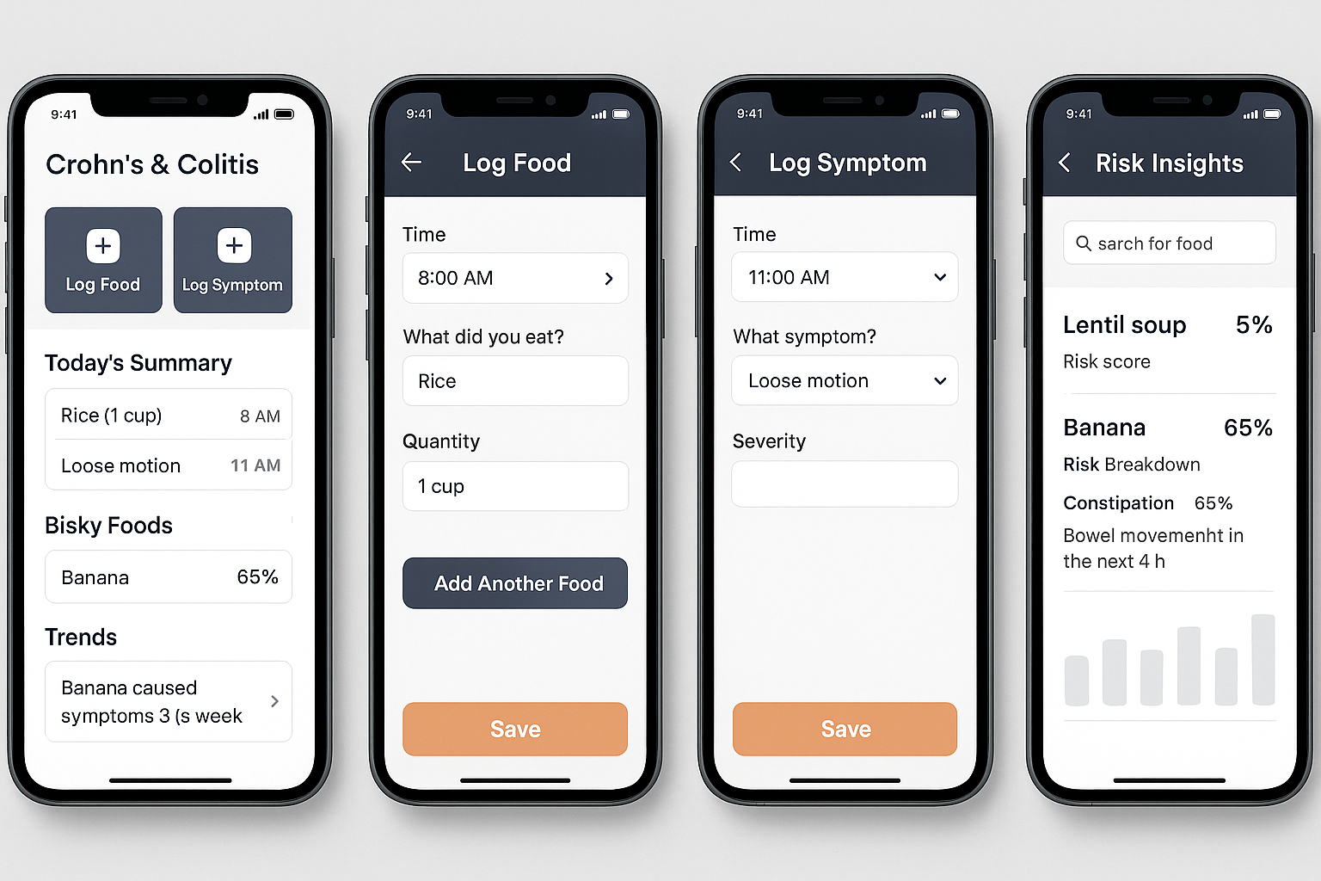
Company Name

Slide 9
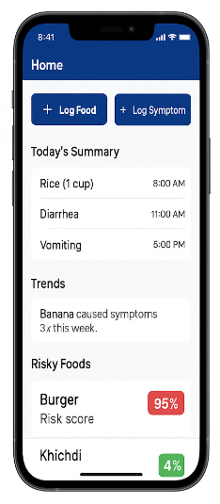

Slide 10
Company Name
Year/Quarter/Month
Temporal association problem.
Multi-window analysis (e.g., 0–4h, 4–8h, 8–24h)
Bayesian Updates:
P(symptom | food) = (α * general_data + β * user_data) / (α + β)

Slide 11
Features
Food item and quantity identification:
Capture before and after photos of food plate
Typed input
Voice inputs
Symptoms recorder:
Typed input
Voice input
Linking symptom with food and temporal aspect to come up with
Risky score for food items
Food item combinations to satisfy nutrient requirements
Symptoms likely to occur along with timeline on taking a risky food item.
Closed-Loop Feedback System: Taking inputs from users what they think caused a particular symptom.
Inputs from weather and sleep data (wearables)
Share your data with your doctor and nutritionist.

Slide 12
Techniques
Build user-specific Bayesian networks (Probabilistic graphs): Over time, the model gets smarter about what causes issues for you, not for the general population

